Slide 1
Advanced Python
Programming Assignment 1

Slide 2
Background: Examples 1

Slide 3
Examples
In the preceding sections we learned enough Python to write real programs.
In this section we will study two complete programs that use only the Python covered earlier.
This is both to show what is possible, and to help consolidate what has been learned so far.
In subsequent slide sets, we will cover more of Python's language and library
We then will be able to write programs that are more concise and more robust than those shown here
But first we must have the foundations on which to build.

Slide 4
Example 1: bigdigits.py
The first program we will review is quite short, although it has some subtle aspects, including a list of lists.
Here is what it does: Given a number on the command line, the program outputs the same number onto the console using "big" digits.
At sites where lots of users share a high-speed line printer, it used to be common practice for each user's print job to be preceded by a cover page that showed their username and some other identifying details printed using this kind of technique.
We will review the code in three parts: the import, the creation of the lists holding the data the program uses, and the processing itself.
On the next slide, we show a sample run of the program.

Slide 5
Examples
$ python bigdigits.py 41072819
* * *** ***** *** *** * ****
** ** * * * * * * * ** * *
* * * * * * * * * * * * *
* * * * * * * *** * ****
****** * * * * * * * * *
* * * * * * * * * *
* *** *** * ***** *** *** *
Since we must read in an argument from the command line (the number to output), we need to access the sys.argv list, so we begin by importing the sys module.
import sys

Slide 6
Examples
We represent each number as a list of strings.
For example, here is zero:
One detail to note is that the Zero list of strings is spread over multiple lines.
Python statements normally occupy a single line, but they can span multiple lines if they are
a parenthesized expression
a list, set, or dictionary literal
a function call argument list
a multiline statement where every end-of-line character except the last is escaped by preceding it with a backslash (\).
In all these cases any number of lines can be spanned and indentation does not matter for the second and subsequent lines.
Zero=[" *** ", " * * ",
"* *",
"* *",
"* * ", " * *", " *** "]

Slide 7
Examples
Each list representing a number has seven strings, all of uniform width, although what this width is differs from number to number.
The lists for the other numbers follow the same pattern as for zero, although they are laid out for compactness rather than for clarity:
One = [" * ", "** ", " * ", " * ", " * ", " * ", "***"]
Two = [" *** ", "* *", "* * ", " * ", " * ", "* ", "*****"]
# …
Nine = [" ****", "* *", "* *", " ****", " *", " *", " *"]
The last piece of data we need is a list of all the lists of digits:
Digits = [Zero, One, Two, Three, Four, Five, Six, Seven, Eight, Nine]

Slide 8
Remaining Code
try: digits = sys.argv[1] row = 0 while row < 7: line = "" column = 0 while column < len(digits): number = int(digits[column]) digit = Digits[number] line += digit[row] + " " column += 1 print(line) row += 1 except IndexError: print("usage: bigdigits.py <number>") except ValueError as err: print(err, "in", digits)
Notes:
Full program should be a handout

Slide 9
Example 2: generate_grid.py
One frequently occurring need is the generation of test data.
There is no single generic program for doing this, since test data varies enormously.
Python is often used to produce test data because it is so easy to write and modify Python programs.
In this subsection we will create a program that generates a grid of random integers
The user can specify how many rows and columns they want and over what range the integers should span
We show on the next slide a sample run of the program

Slide 10
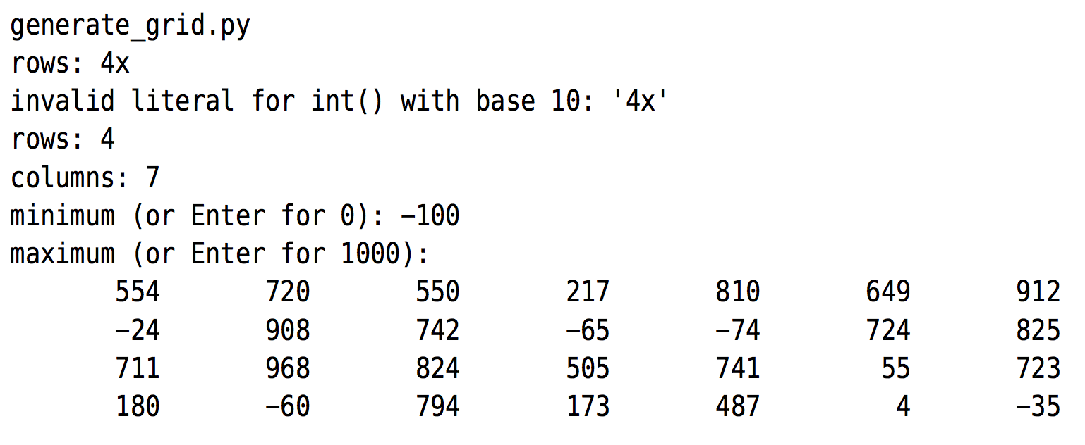
Sample Run of generate_grid.py

Slide 11
Example 2: generate_grid.py
The program works interactively
At the beginning we made a typing error when entering the number of rows.
The program responded by printing an error message and then asking us to enter the number of rows again.
For the maximum we just pressed Enter to accept the default.
We will review the code in four parts:
the import
the definition of a a more sophisticated get_int() function
the user interaction to get the values to use;
and the processing itself.
We will need the random module to give us access to the random.randint() function.

Slide 12
Example 2: generate_grid.py
import random
def get_int(msg, minimum, default): while True: try: line = input(msg) if not line and default is not None: return default i = int(line) if i < minimum: print("must be >=", minimum) else: return i except ValueError as err: print(err)
Notes:
This function requires three arguments: a message string, a minimum value, and a default value. If the user just presses Enter there are two possibilities. If default is None, that is, no default value has been given, the flow of control will drop through to the int() line. There the conversion will fail (since '' cannot be converted to an integer), and a ValueError exception will be raised. But if default is not None, then it is returned. Otherwise, the function will attempt to convert the text the user entered into an integer, and if the conversion is successful, it will then check that the integer is at least equal to the minimum that has been specified.
So, the function will always return either default (if the user just pressed Enter), or a valid integer that is greater than or equal to the specified minimum.

Slide 13
Example 2: generate_grid.py
rows = get_int("rows: ", 1, None) columns = get_int("columns: ", 1, None) minimum = get_int("minimum (or Enter for 0): ", -1000000, 0) default = 1000 if default < minimum: default = 2 * minimum prompt = "maximum (or Enter for " + str(default) + "): " maximum = get_int(prompt, minimum, default)
Our get_int() function makes it easy to obtain the number of rows and columns and the minimum random value that the user wants.
For rows and columns we give a default value of None, meaning no default, so the user must enter an integer.
In the case of the minimum, we supply a default value of 0
For the maximum we give a default value of 1 000, or twice the minimum if the minimum is greater than or equal to 1 000.

Slide 14
Example 2: generate_grid.py
Once we know how many rows and columns the user requires and the minimum and maximum values of the random numbers they want, we are ready to do the processing.
row = 0 while row < rows: line = "" column = 0 while column < columns: i = random.randint(minimum, maximum) s = str(i) while len(s) < 10: s=""+s line += s column += 1 print(line) row += 1
Notes:
To generate the grid we use three while loops, the outer one working by rows, the middle one by columns, and the inner one by characters. In the middle loop we obtain a random number in the specified range and then convert it to a string. The inner while loop is used to pad the string with leading spaces so that each number is represented by a string 10 characters wide. We use the line string to accumulate the numbers for each row, and print the line after each column's numbers have been added.

Slide 15
Notes About Our Two Examples
Python provides
very sophisticated string formatting functionality
excellent support for "for … in" loops
So more realistic versions of both bigdigits.py and generate_grid.py would have used "for ... in" loops
Moreover, generate_grid.py would have used Python's string formatting capabilities rather than crudely padding with spaces.

Slide 16
Programming Assignments

Slide 17
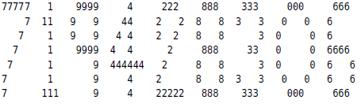
bigdigits2.py
One nice variation of the bigdigits.py program is where instead of printing * characters, the relevant digit is printed instead.
For example:
bigdigits_ans.py 719428306
Two approaches can be taken. The easiest is to simply change the * characters in the lists.
But this isn’t very versatile and is not the approach you should take.
Instead, change the processing code so that rather than adding each digit’s row string to the line in one go, you add character by character, and whenever a * is encountered you use the relevant digit.
This can be done by copying bigdigits.py and changing about five lines.
It isn’t hard, but it is slightly subtle.

Slide 18
awfulpoetry1.py
In some situations we need to generate test text
For example
to populate a web site design before the real content is available
to provide test content when developing a report writer
To this end, write a program that generates awful poems (the kind that would make a Vogon blush)
Create the following lists of words: articles, subjects, verbs, and adverbs
Examples:
articles = [“the”, “a”, “another” ]
subjects = [cat”, “dog”, “man”, “woman”]
verbs = [“sang”, “ran”, “jumped”, ”hoped”, ”laughed”]
adverbs = [“loudly”, “quietly”, “well”, “badly”]

Slide 19
awfulpoetry1.py
You will need to import the random module
Next, loop five times, and on each iteration use the random.choice() function to pick an article, subject, verb, and adverb.
Use random.randint() to choose between two sentence structures:
article, subject, verb, and adverb
article, subject, and verb
Then print the sentence.
Here is an example run:
another boy laughed badly
the woman jumped
a boy hoped
a horse jumped
another man laughed rudely

Slide 20
awfulpoetry2.py
Make the awful poetry program more versatile as follows
Add some code to it so that if the user enters a number on the command line (between 1 and 10 inclusive), the program will output that many lines
If no command-line argument is given, default to printing five lines as before.
Recall: the command line arguments are in sys.argv[1:]
You’ll need to change the main loop (e.g., to a while loop)
Keep in mind that Python’s comparison operators can be chained, so there’s no need to use logical and when checking that the argument is in range.
The additional functionality can be done by adding about ten lines of code.

